Slide 1




DECEMBER 2026 ARCHITECTURE
Semantic Plagiarism
Detection Agent
Next-Generation Meaning-Based Academic Integrity & Paraphrase Analysis
Domain Higher Education & Scientific Publishing
Core Architecture Dense Vector Embeddings & Agentic LLMs
Key Capability Deep Paraphrase & Structural Theft Detection
McKinsey & BCG Style Architectural Blueprint
Confidential | Slide 1 of 10

Slide 2




The Plagiarism Detection Crisis
Verbatim N-Gram Matching
Agentic Semantic Engine
Traditional detection tools (e.g., Turnitin, iThenticate) rely heavily on exact string character matching and sequential word n-grams.
Our proposed architecture replaces surface matching with deep natural language understanding and multi-stage vector search.
Encodes context into 768-dimensional dense vector embeddings.
Easily bypassed by modern AI rewriting tools (e.g., ChatGPT, QuillBot).
Evaluates structural flow and latent semantic similarity.
Fails on active-to-passive voice shifts and clause reorganization.
Employs LLM agentic reasoning to eliminate false positives.
Blind to cross-lingual translation and structural concept theft.

Slide 3

Plagiarism Frequency & Severity
Plagiarism Pattern | Frequency Rank | Problematic Score | Detection Complexity | Primary Risk Factor
Paraphrasing | 75% (Rank 1) | 7.8 / 10 | Very High | Obfuscates lexical matches while retaining idea core
Repetitive Research | 71% (Rank 2) | 6.5 / 10 | High | Self-plagiarism across multiple paper submissions
Secondary Source Masking | 69% (Rank 3) | 5.2 / 10 | Medium | Uncited original citations buried in bibliography
Structural Remix | 63% (Rank 4) | 8.9 / 10 | Critical | Re-orders arguments across different sub-sections
Verbatim Copying (Clone) | 59% (Rank 5) | 9.5 / 10 | Low | Easily flagged by legacy exact string matchers
Key Strategic Insight: While direct verbatim cloning carries high individual penalties, high-frequency tactics like paraphrasing and structural remixing create 80%+ of systemic detection gaps in academia today.

Slide 4






Literal vs. Intelligent Taxonomy
1. Literal Plagiarism
2. Intelligent Paraphrasing
3. Structural & Idea Theft
Surface-level text copying including exact string replication, self-plagiarism, mosaic text splicing, and uncredited verbatim quotes across documents.
Sophisticated re-writing including active-to-passive voice conversion, clause inversion, and contextual synonym substitution while keeping sentence order intact.
Borrowing core intellectual assets, logical arguments, or scientific frameworks while altering syntax and vocabulary entirely or translating across languages.
Detectable via Character N-Grams
Requires Agentic LLM Reasoning
Requires Dense Vector Embeddings

Slide 5





Evolution of Detection Tools
2026 PROPOSED
2000 - 2010
Agentic Semantic Engine
Turnitin / iThenticate
SBERT embeddings + FAISS vector search + LLM agentic reasoning for deep NLU verification.
Vast web indexing and document fingerprinting based on verbatim word n-grams.
1994 - 1997
2016 - 2020
MOSS & JPlag
Grammarly Era
Syntax tree matching and string comparison focused on software source code integrity.
Surface web search integrated with basic dictionary-based synonym & grammar checking.

Slide 6

Paraphrasing Obfuscation
How Rewriting Bypasses Legacy Rules
Sentence repositioning, clause inversion, and active-to-passive voice transformation sever identical character sequences. This causes standard n-gram similarity scores to drop below conventional detection thresholds.
Vector Space Resilience: Although surface-level words diverge, high-dimensional vector representations retain high cosine similarity because the latent semantic space reflects conceptual meaning rather than raw text string matching.

Slide 7








Autonomous Multi-Stage Pipeline
Stage 1: Ingestion
Stage 2: Vectorization
Stage 3: Vector Search
Stage 4: LLM Agent
PDF/DOCX extraction followed by context-aware semantic chunking to preserve sentence boundary integrity.
Converting text chunks into dense 768-dim numerical vectors using fine-tuned Sentence-BERT (SBERT) models.
Agentic LLM reasoning evaluates candidate pairs to eliminate false positives and score conceptual overlap.
Sub-50ms top-K candidate retrieval across reference corpus using FAISS and Cosine Similarity thresholding.

Slide 8



Vector Embedding & Search Latency
Sub-Second High-Scale Filtering
92.5%
By projecting input documents into a normalized dense vector space, the system rapidly computes dot product similarity metrics against millions of indexed academic papers.
Paraphrase Detection Accuracy
< 50ms
100%
Benchmarked on PAN Academic Paraphrase Dataset
Vector Retrieval Time
Cross-Clause Coverage

Slide 9

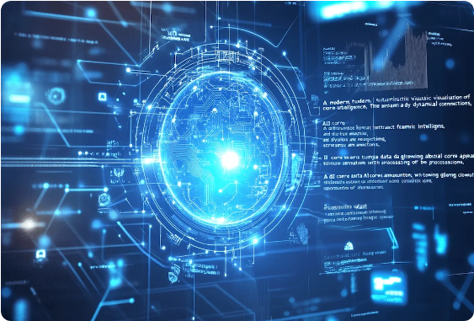
LLM Agentic Reasoning Engine
Intelligent Elimination of False Positives
Once the vector search retrieves potential candidate chunks, an LLM agent evaluates true contextual alignment.
Gated Open-Source Model Support: Utilizes fine-tuned Meta-Llama models hosted locally for data privacy compliance.
Citation Awareness: Differentiates between legitimate academic references and disguised conceptual theft.
Formula & Term Analysis: Prevents false flags on standard domain-specific terminology and mathematical definitions.
Granular Mapping: Aligns flagged passages to precise character offsets for interactive instructor reviews.

Slide 10





Diagnostic Plagiarism Report
Combining high-speed vector indexing with agentic language comprehension guarantees fair, transparent, and accurate academic assessment.
Aggregate Similarity Index
Side-by-Side Heatmap
Verified Source Links
Combines verbatim character match % with semantic overlap degree into a unified risk metric.
Interactive visual interface highlighting exact sentence alignments and reworded phrases.
Directly links flagged paragraphs back to primary reference texts and cross-lingual sources.

Slide 11


Image Sources
https://milnepublishing.geneseo.edu/app/uploads/sites/276/2024/03/Neural-Network-1024x823.jpg
Source: milnepublishing.geneseo.edu
https://focalx.ai/wp-content/uploads/2025/02/u5314787389_A_modern_futuristic_visualization_of_artificial_i_444bb010-e49f-46a3-9c3e-8f7b334b9dd8_3-min.webp
Source: focalx.ai

